Slide 1
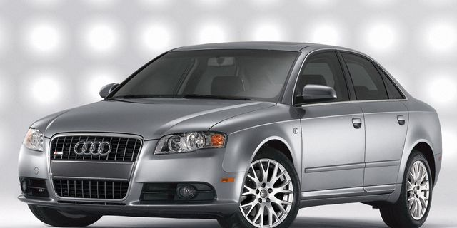
Machine Learning
Predicting The Asking Price for:
Used Car Vehicle Listings
on Craigslist.org
by
Robert Harris

Slide 2

So, it’s time to shop used cars.
You’re a savvy Craigslist shopper.
What’s an appropriate price for that M3?
Information is power!
Time to do some research.
Note – Prior to the 2022 chip shortage!

Slide 3

Where to begin?
So many features:
Low miles, garage kept, granny driven, …
A4/S4, A5/S5, A6/S6, A7/S7/RS7, …
1 car, 2 car, red car, blue car, …
Information overload!
AI: Machine Learning has you covered!
Clean data in -> accurate price out

Slide 4

Data Snapshot – Prepped for input:
Size constraints.
Standard missing values and cleaning.
Outliers:
Odometer = 0 -10,000,000 miles
Price = 0 - $2,808,348,671
Older vehicles.
Incorrectly categorized:
Tractors, motorcycles, other, etc.
model = ‘civic bad credit’

Slide 5
Findings – data split train/validate/test:
All models performed reasonably well after data prep.
Random Forest stood out becoming the Go-To benchmark.
Highlights from the unseen test data (n=10):
3 prices were within $100 of list price (1 within $10).
3 more predicted prices were within $500.
Worst case had model estimating $5681 for a 2001 Chevy Silverado with 186K miles that was listed at $8750.

Slide 6
Test Results Snapshot (MAE=$884):
Modeled Listed Year Make Model Miles Color Condition …
$10,996 $10,990 2014 chevy malibu 47,466 other good
$23,086 $22,990 2014 audi q7 tdi 88,427 blue good
$8,914 $8,995 2007 honda pilot 140,048 grey excellent
$5,244 $5,400 2005 benz e320 140,560 silver good
$21,500 $21,899 2017 chevy suburb 164,688 black other
$15,405 $14,899 2008 chevy avalan 144,136 custom other
: :
$5,681 $8,750 2001 chevy silvera 186,238 blue excellent
$23,748 $22,999 2018 honda civic si 44,472 black excellent

Slide 7

Specific Process:
EDA / Cleaning / Pre-Processing:
Numeric
Price (target): 0 or Nan -> Dropped
Outliers dropped at [0.5, 0.95]
Year: 2000 and later
Odometer: Nan -> Rolling average
*Sorted by Manufacturer/Model/Year
Outliers – Same as price

Slide 8
Feature Engineering:
Categoric
Region: v1 ignored, v2 compared n=29
Manufacturer: Ave price/manucturer per year
Make: Ave price/make per year
Condition, Color,
Cylinders, Type: One-Hot encoding
Fuel: gas vs !gas
Transmission: auto vs !auto
Title: clean vs !clean

Slide 9
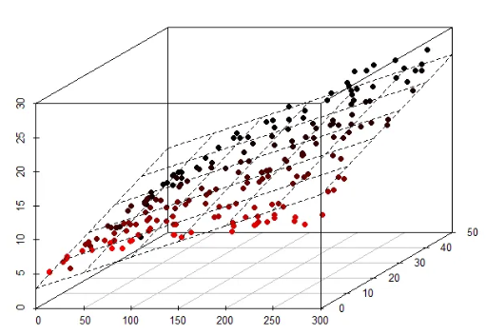
ML Algorithms:
*Scaled non binary features -> [0, 1]
Baseline Model – OLS Linear Regression
Regularization Techniques
Ridge Regression
Lasso Regression
Random Forest

Slide 10

Metric Results:
Cross-Validation (5-Folds) comparison results:
cv R-sq RMSE MAE MAPE
OLS 95.545 0.95392 2062.200 1223.63 10.68
Ridge 95.550 0.95392 2062.202 1223.77 10.69
Lasso 95.550 0.95388 2063.090 1217.62 10.61
96.119 0.96479 1802.604 883.91 7.85

Slide 11
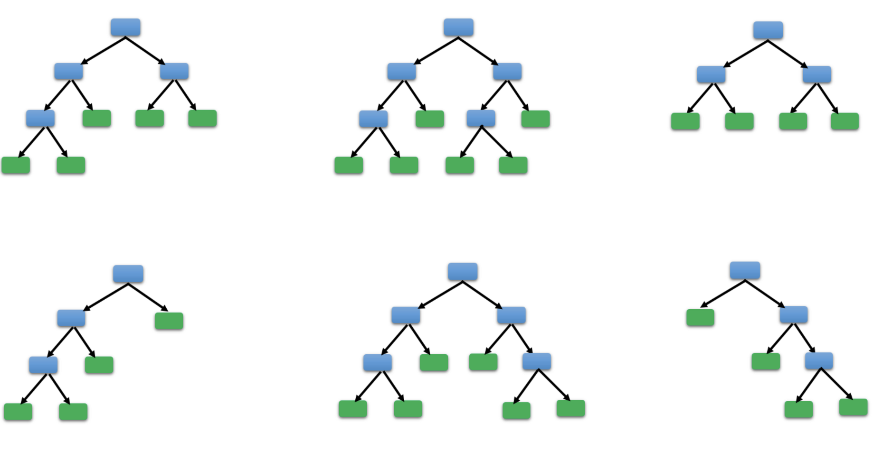
Summary:
Random Forest Regressor Model
Predicts used car listing prices that are within:
$884 of the average listing price.
7.85% of the average listing price.
Furthermore, the model’s features account for 96.5% of the variance in the listing price.

Slide 12

Further Investigation:
Break data down by region.
Aggregate various price points per feature(s).
This dataset ended in late 2020. It would be nice to compare price fluctuations given the current market.
Sales price is not known. Having sales price would open up many more analytic options for optimization.
Integrate data into a interactive Tableau Dashboard.

Slide 13


References
Dataset - kaggle:
Used Cars Dataset - Vehicle listings from Craigslist.org
Author: Austin Reese
Code:
Github.com/rharris4080/Capstone2
In Conclusion:

Slide 14
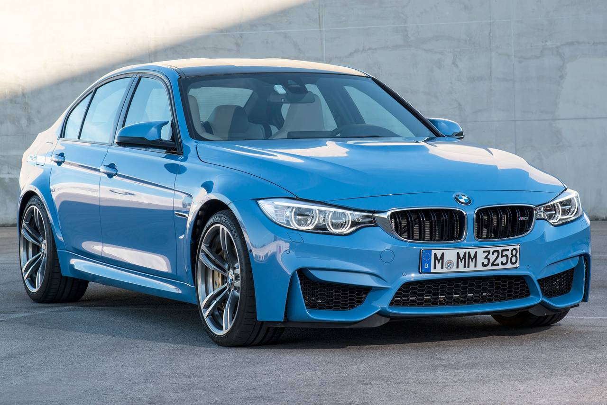
Happy Shopping!

